Slide 1
Jason Del Gandio, Ph.D. Temple University jasondelgandio@gmail.com
The EDM Vibe:
More than Affect

Slide 2
Overview
How do EDM scholars theorize the vibe?
Is the vibe just another word for “affect”?
bodies affect bodies
“social-aesthetic relations”
How might EDM scholars expand their approach to theorizing the vibe?

Slide 3
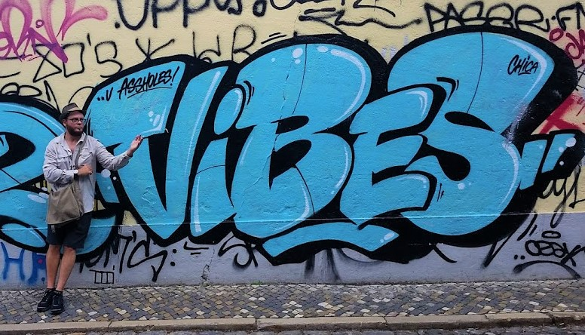
A Few Bio Points
First rave – 1992
Dissertation – the vibe (2002)
Social Justice
The vibe – lifelong interest
New to EDM scholarship

Slide 4
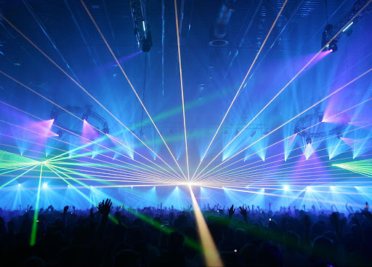
Expanding the Conversation
The Vibe
Metaphor or Ontology?

Slide 5
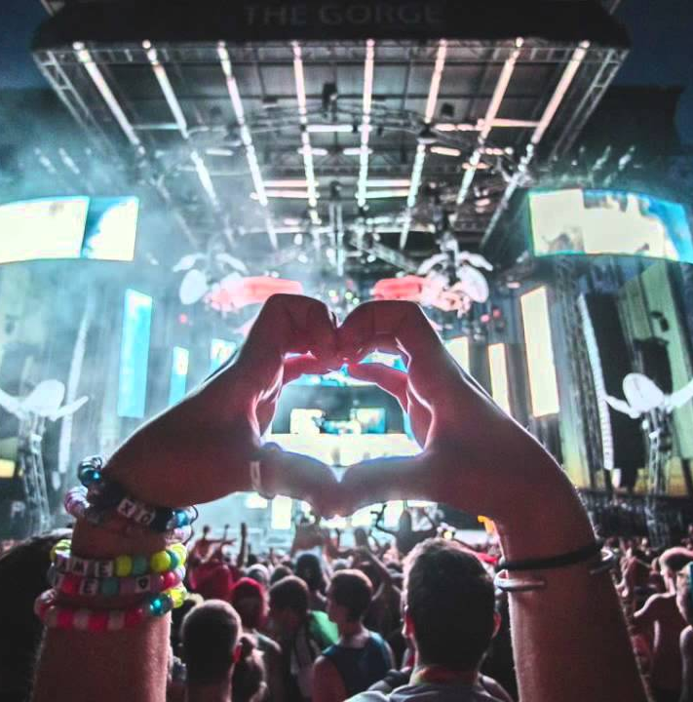
Vibe as Metaphor
Another word for “affectivity”?
A general catchphrase?
emotion
feeling
mood
atmosphere
etc…

Slide 6
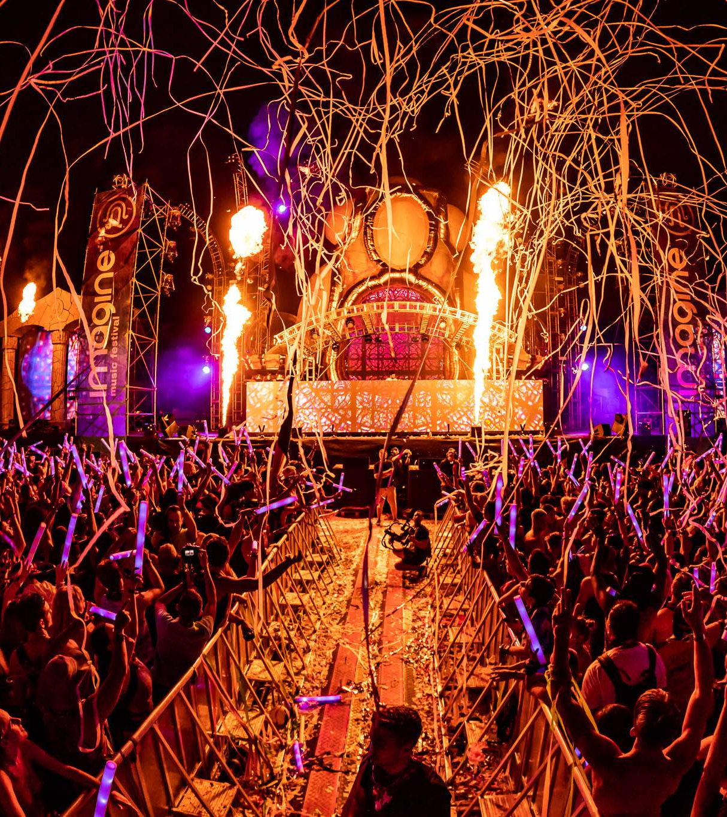
The Vibe as Ontology
But what is its nature?
Physical
Metaphysical
Both
Something else…

Slide 7
Vibe as Physical
Quantum Physics
vibrating atoms
Light Particles/Waves
Sound Vibrations
Electromagnetic Energy
see the HeartMath Institute

Slide 8
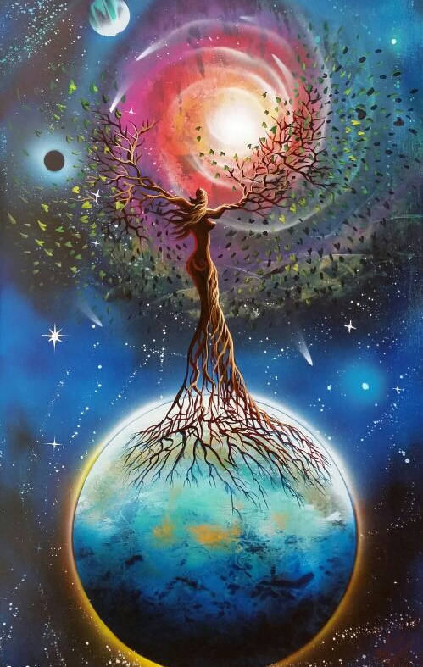
Vibe as Metaphysical
Primordial Energy - Original Source
Mysticism
Western Scholarship vs EDM Experience
Global & Cross-Cultural
Shamanism
Eastern Spirituality
Indigenous Cosmologies

Slide 9
And still…
Can it be both physical and metaphysical?
Perhaps neither physical nor metaphysical?
All the above?

Slide 10
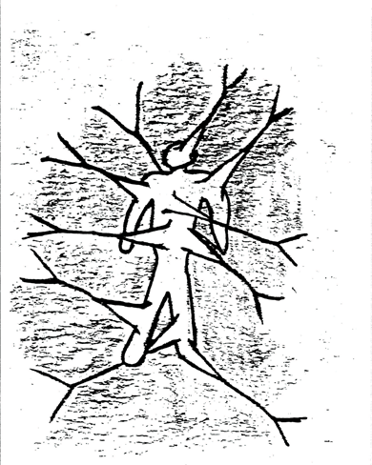
My Own Theory
Vibe = Bodily Emanation
Bodily Emanation
a tangible felt-energy that perpetually radiates from our bodies
A Heuristic

Slide 11
Levels & Modes of Bodily Emanation
Interpersonal
Small/Large Group
Local/Regional
Cultural
Global
A form of communication
A way of knowing
An existential guide for moving through the world

Slide 12
A Universal Vibe
animals, insects, and microscopic living organisms
trees, plants, and blades of grass
Earth, moon, sun, and stars
Moving beyond the Western paradigm
Decentering the human

Slide 13
Thanks! jasondelgandio@gmail.com *sources upon request *email me your work *images found online

